Slide 1

Differentiable Programming for System Identification and Control of Energy Systems
Invited Talk at Pennsylvania State University
26th of October 2021
Jan Drgona
Collaborators: Aaron Tuor, Mia Skomski,
Soumya Vasisht, Ethan King, Vikas Chandan,
Shrirang Abhyankar, Draguna Vrabie

Slide 2
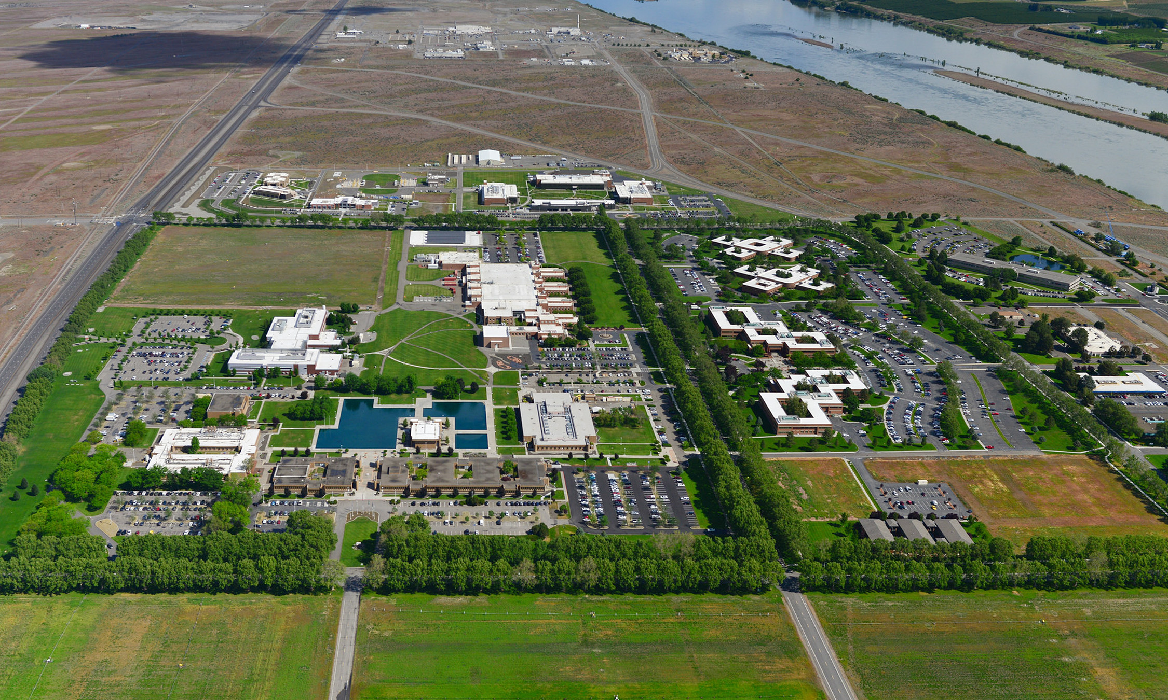





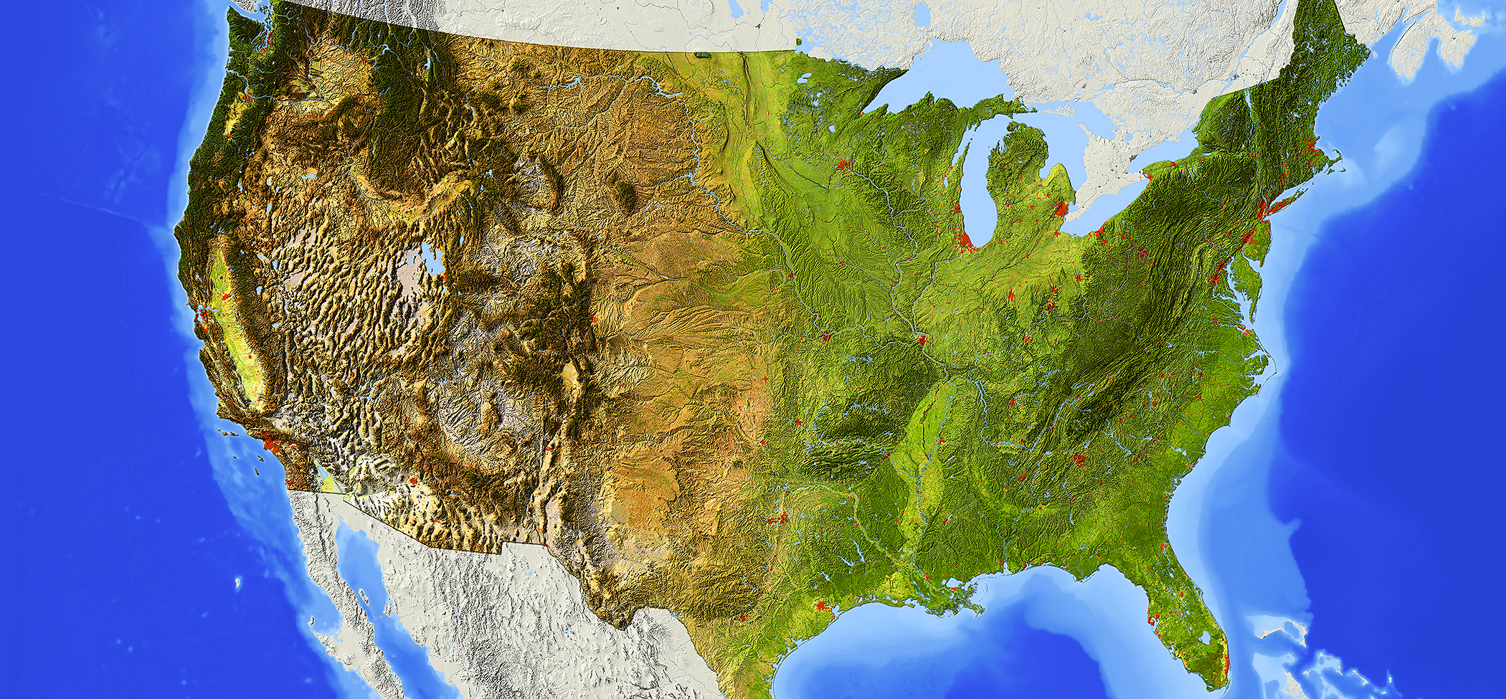

















The DOE National Laboratory “without laboratories, men of science are soldiers without arms” – Louis Pasteur
Pacific Northwest National Laboratory
Address complex challenges and provide solutions to critical national needs
DOE’s 17 national laboratories tackle critical scientific challenges

Slide 3
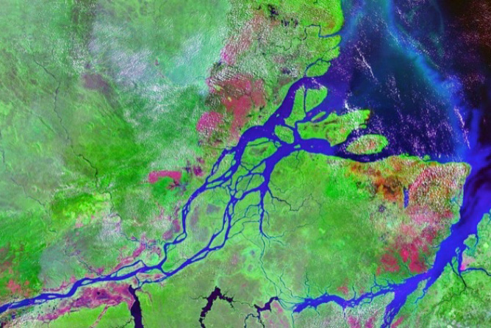
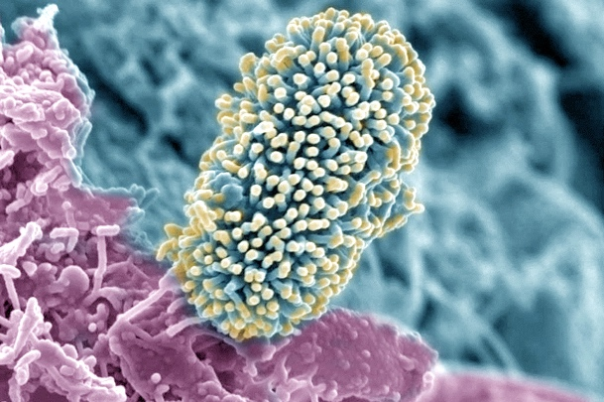

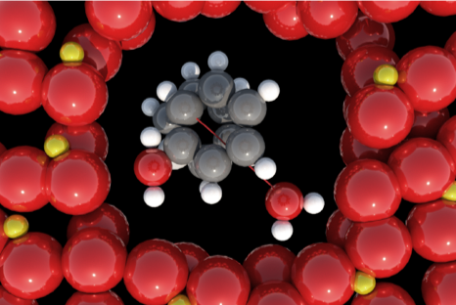
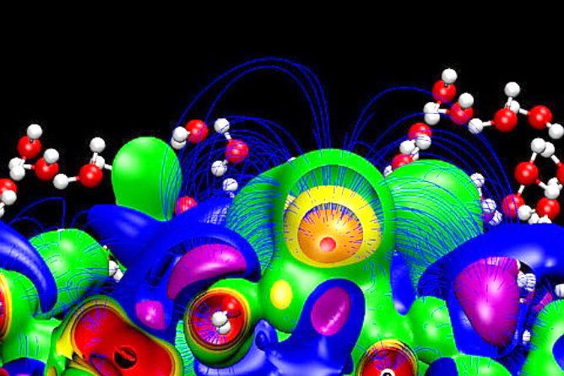

PNNL’s Scientific Discovery Mission
understanding the complex world around us
DOE User Facilities (EMSL, ARM)
Earth Systems Science
Biological Systems Science
Chemical and Materials Sciences
Advanced Computing
Nuclear and Particle Physics

Slide 4
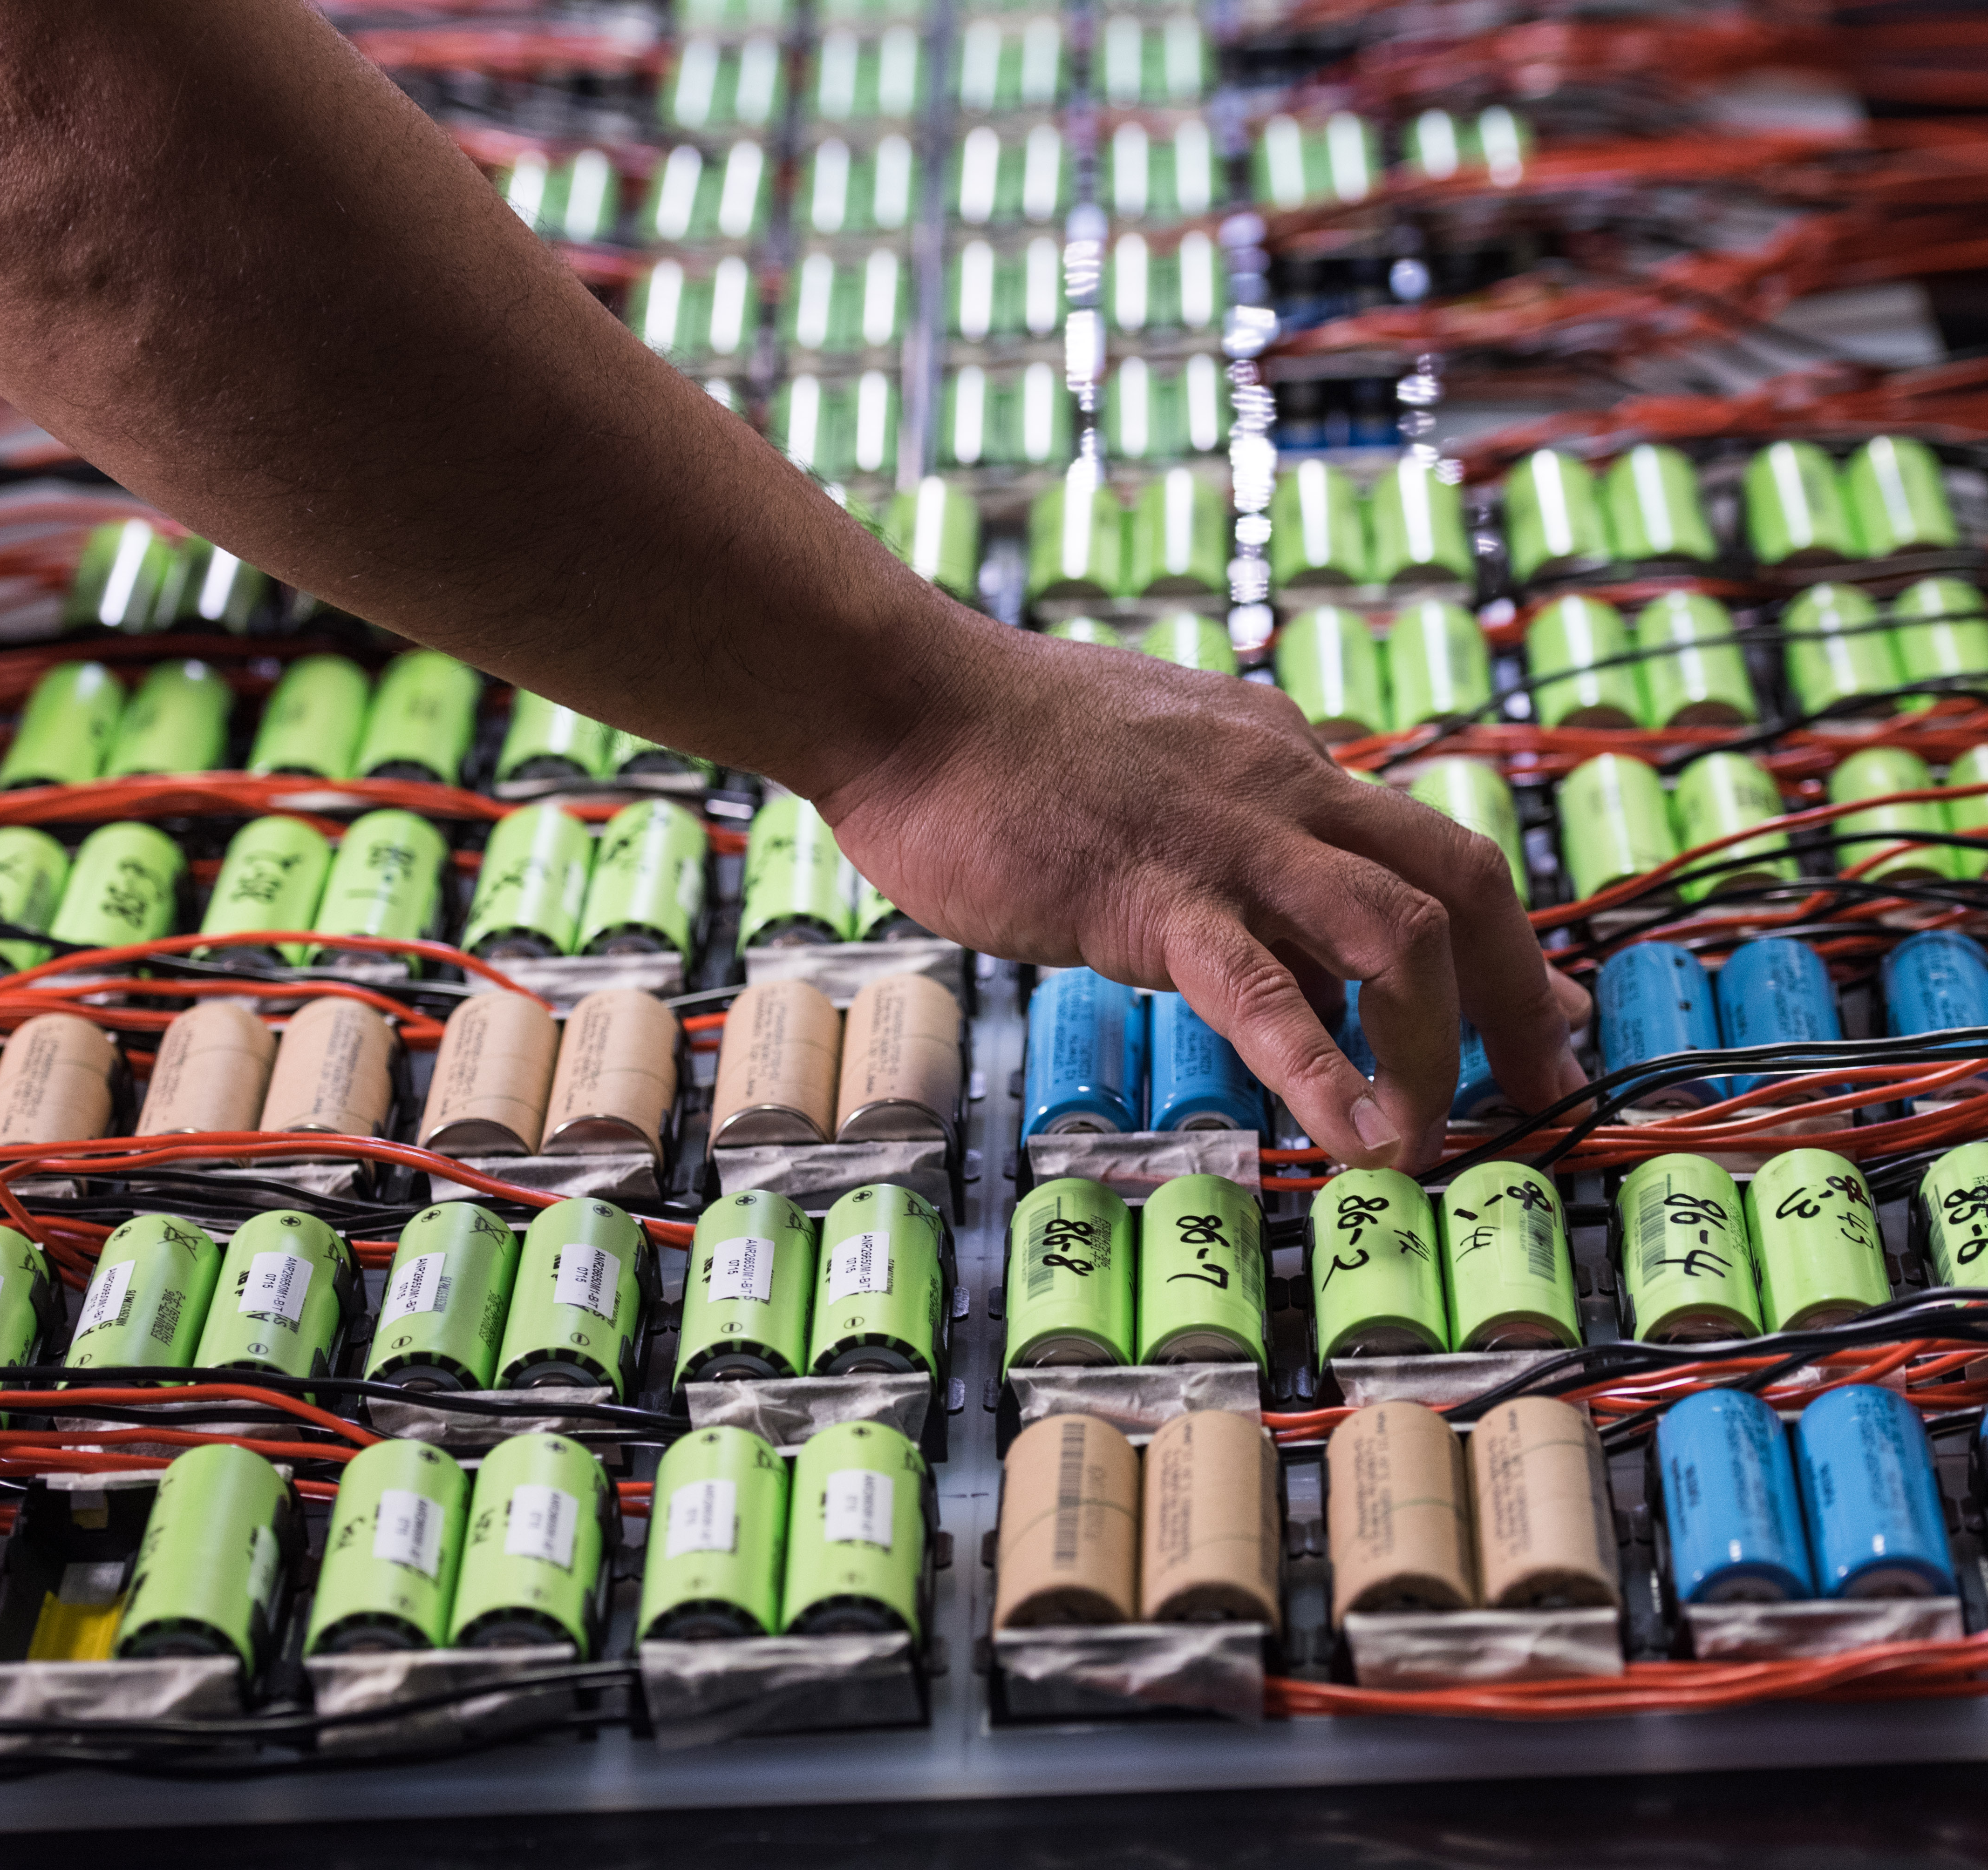
Energy Resiliency
Analytics, deep learning and high-performance computing to model extreme events
Tools for predictive, real-time capabilities to improve performance and cybersecurity
Data analytics for discovering synthesis, prototyping and testing new materials
Notes:
Image: Research at PNNL includes development of materials and batteries for stationary energy storage applications, as well battery testing, as shown in this photo. With growing national and international interest in clean, sustainable energy, stationary energy storage will be vital to adding renewables (wind and solar power, etc.) to the power grid, and perhaps even to making the smart grid a reality.

Slide 5
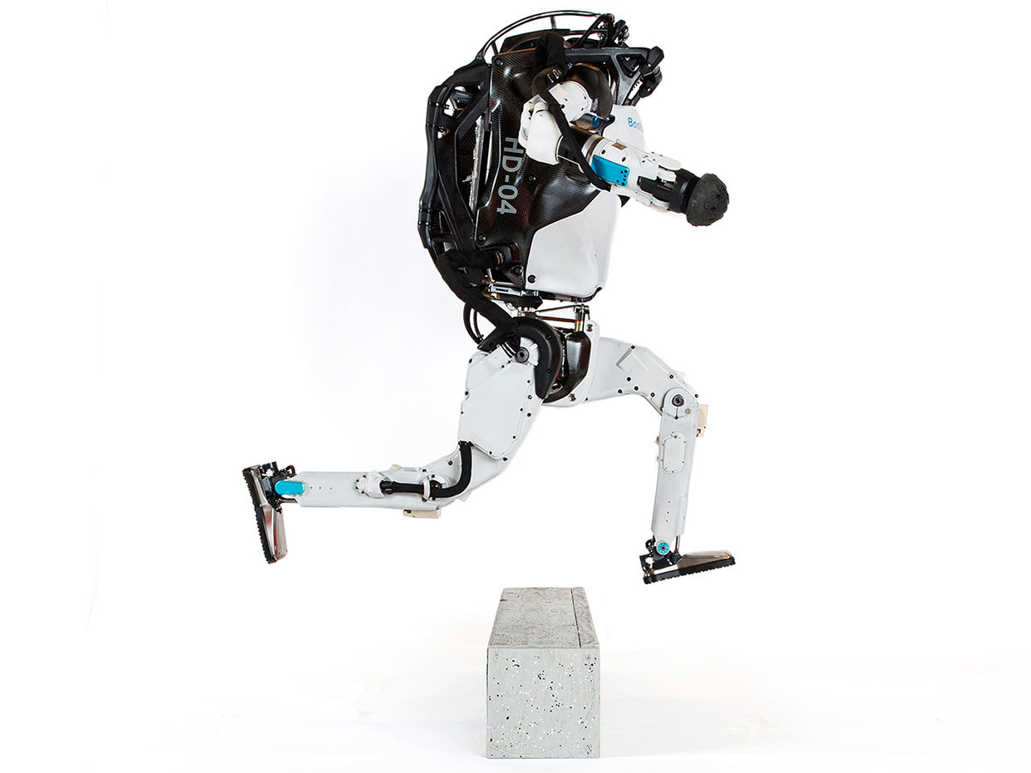


Model Predictive Control
Successes
Challenges
95% of the process control applications are PID loops using trial and error rule-based optimization. The rest is model predictive control (MPC).
Modeling
Unknown or partially known dynamics
Physics-based modeling is expensive
Purely data-driven models lack generalization
Real-time optimization
Scalability
Computational limitations of control hardware
Parallelization, distributed optimization
Assumption:
Reliable and accurate system dynamics model
Drgona J., J. Arroyo, I.C. Figueroa, D. Blum, K. Arendt, D. Kim, and E.P. Olle, J. Oravec, M. Wetter, D. L. Vrabie, L. Helsen. 2020. "All You Need to Know About Model Predictive Control for Buildings." Annual Reviews in Control, September 29, 2020

Slide 6
Model Predictive Control
Main characteristics of MPC
Uses models
Makes predictions
Optimizes control decisions over a prediction horizon
PID
Notes:
MPC was first developed in the chemical industry where it is used as a supervisory controller to optimize the operation of complex multi-input and multi-output processes.
- Add a slide with MPC as optimization problem

Slide 7
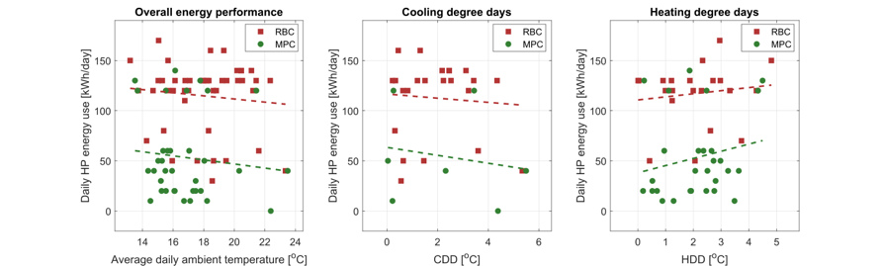
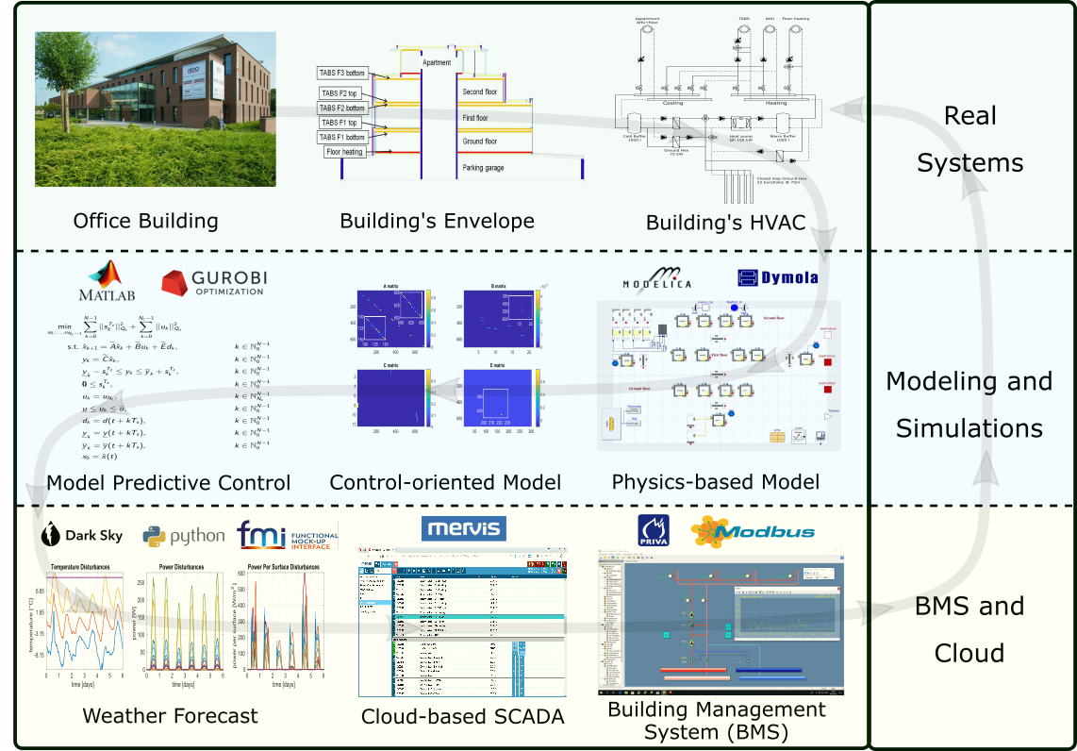
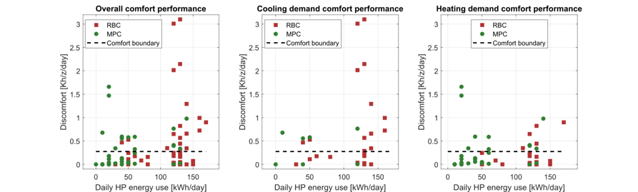

Implementation of MPC in Office Building in Belgium
The field test energy use performance of MPC (green) and RBC (red) during the transient season. Each dot represents one day.
The field test thermal comfort performance of MPC (green) and RBC (red) during the transient season. Each dot represents one day.
Highlights: Heat pump energy savings up to 53%.
Thermal comfort improvement up to 37%.
Drgona J., et al., Cloud-based implementation of white-box model predictive control for a GEOTABS office building: a field test demonstration. Journal of Process Control, 2020.

Slide 8
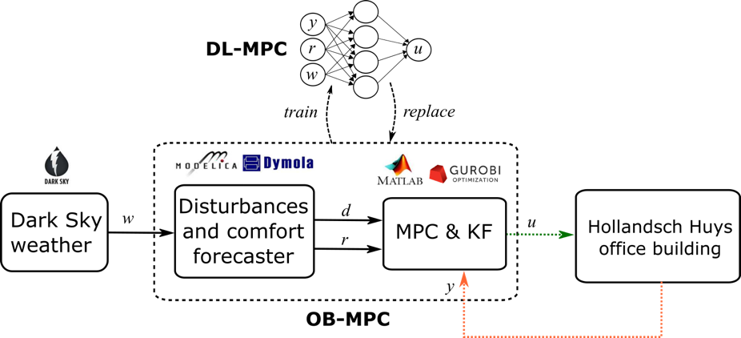
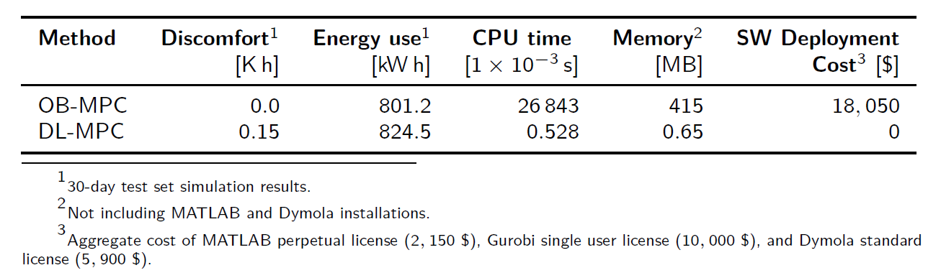
Imitation Learning of MPC Policies
Pros
Can accurately approximate MPC
Low CPU and memory demands
Cons
Loosing performance guarantees
Still relies on original MPC
Drgona J., et al., “Approximate model predictive building control via machine learning,” Applied Energy, 2018
Drgona J., Helsen L., Vrabie D., “Stripping off the implementation complexity of physics-based model predictive control for buildings via deep learning.” NeurIPS Climate Change AI workshop, 2019.
Drgona J., Helsen L., Vrabie D., "Cutting the Deployment Costs of Physics-Based MPC in Buildings by Simulation-Based Imitation Learning.”, proceedings of Dynamic Systems and Control Conference 2020, - Best paper award

Slide 9

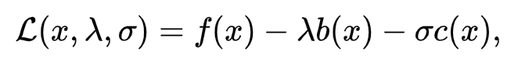
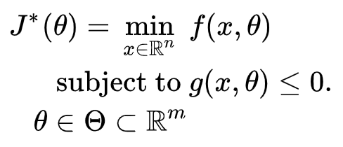

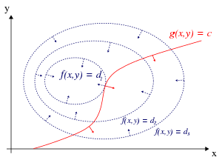
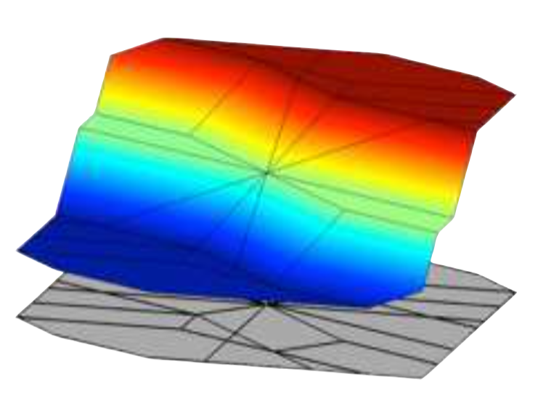


Optimization as Lingua Franca for Scientific Computing
Standard form
Lagrangian form
Parametric programming
Machine learning
“online” optimization
single solution for
given parameter values
“online” optimization
using soft constraints
instead of hard constraints
“offline” optimization
obtains a solution map
for a set of parameters
“offline” optimization
obtains a model (map)
for a set of datapoints
Differentiable parametric programming (DPP): formulating parametric programming in Lagrangian form with solutions based on automatic differentiation

Slide 10
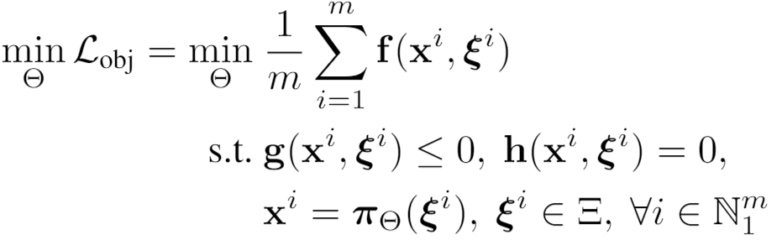
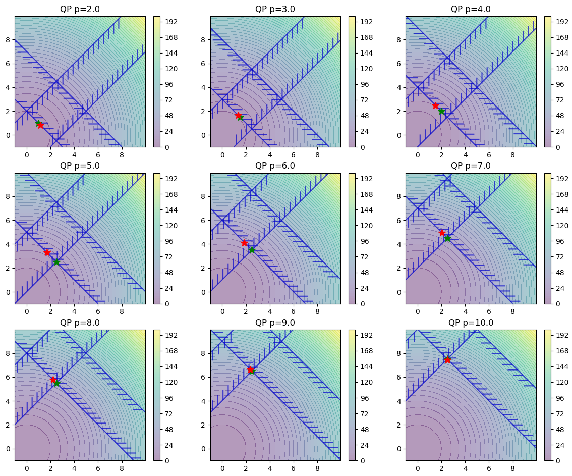
NeuroMANCER: Differentiable Programming Framework
Open-source under construction
https://github.com/pnnl/neuromancer
Parametric solution of quadratic program
train_data,dev_data,test_data = get_dataloaders(samples)
map = policies.MLPPolicy({**dims},input_keys=["p”],name='map')
x = Variable(f"U_pred_{map.name}", name='x')[:, :, [0]]
y = Variable(f"U_pred_{map.name}", name='y')[:, :, [1]]
p1 = Variable('p1') f = x ** 2 + y ** 2 obj = f.minimize(weight=Q, name='obj’) g1 = -x - y + p1 con_1 = Q_con*(g1 <= 0)
objectives = [obj]
Constraints = [con_1] components = [map] model = Problem(objectives, constraints, components) optimizer = torch.optim.AdamW(model.parameters(), lr=args.lr) trainer = Trainer(model,train_data,dev_data,test_data,optimizer)
best_model = trainer.train()

Slide 11
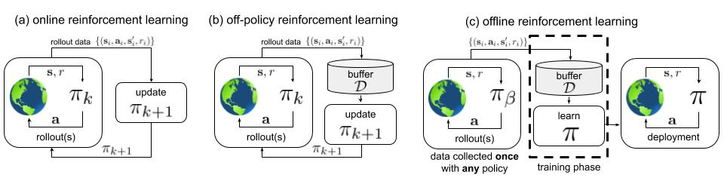
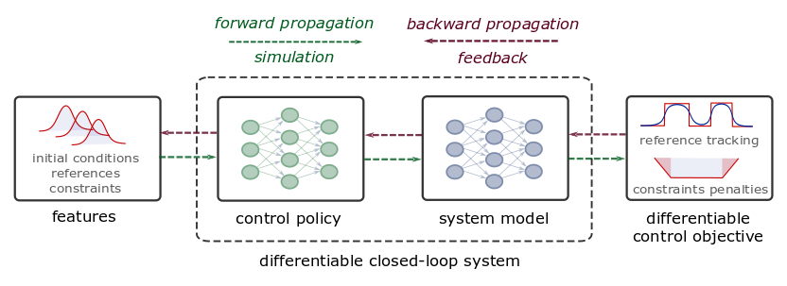
Differentiable Predictive Control
Reinforcement Learning
Learn:
policy, Q function, (model)
Gradients via Q functions
https://arxiv.org/abs/2005.01643
Differentiable Predictive Control (DPC)
Learn:
policy, model, (objectives, constraints)
Gradients via differentiable MPC objective
Constrained, model-based
Stability analysis on closed-loop dynamics
Jan Drgona, et al., Differentiable Predictive Control: An MPC Alternative for Unknown Nonlinear Systems using Constrained Deep Learning https://arxiv.org/abs/2011.03699
Jan Drgona, Aaron Tuor, Draguna Vrabie, Constrained Physics-Informed Deep Learning for Stable System Identification and Control of Unknown Linear Systems https://arxiv.org/abs/2004.11184

Slide 12
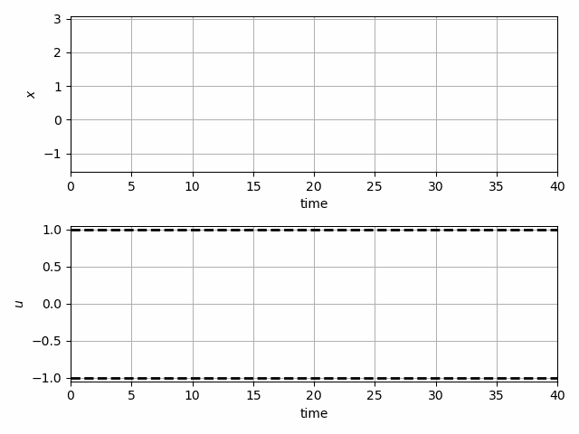
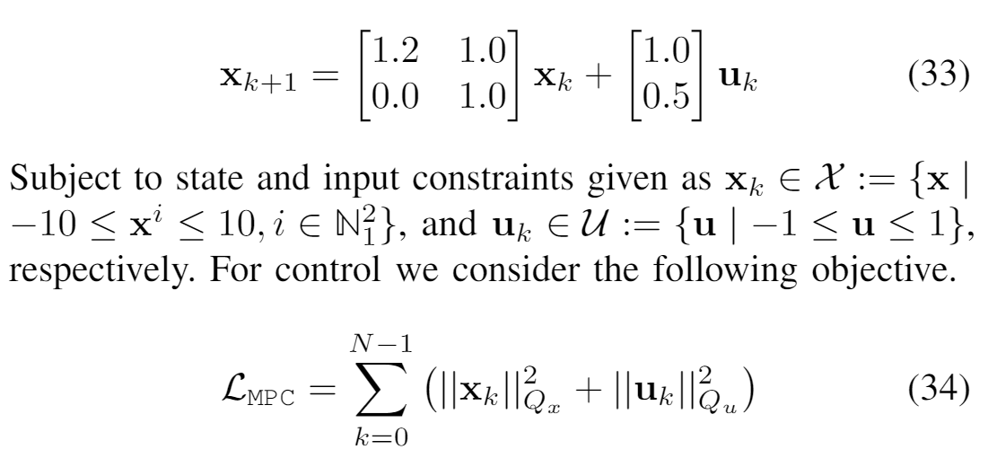
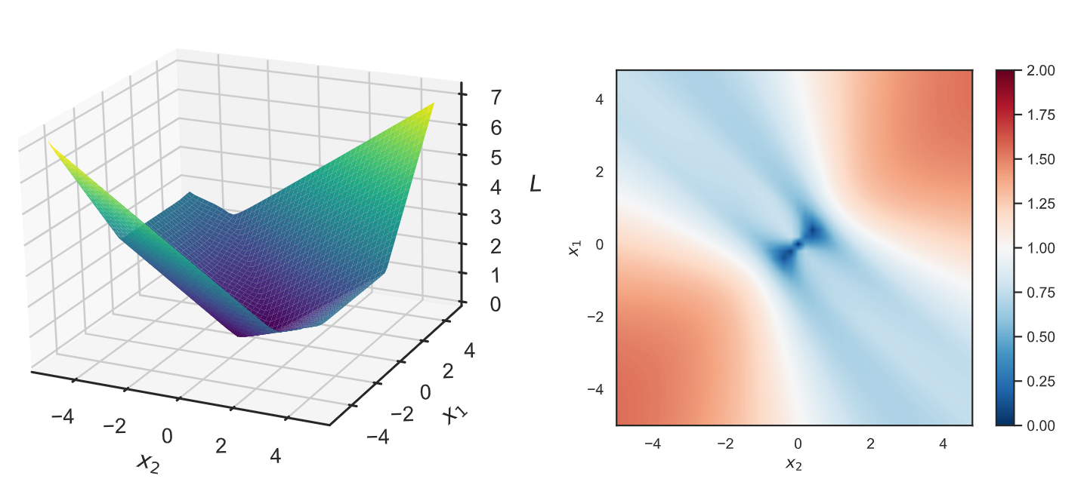
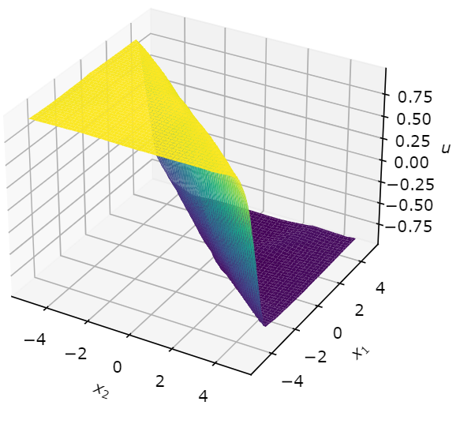
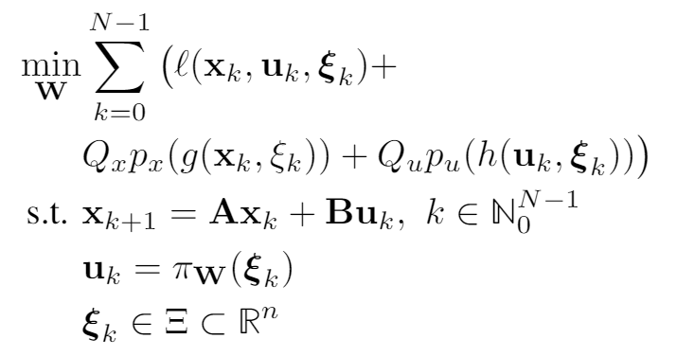
Learning to Stabilize Unstable System with DPC
Problem setup:
DPC formulation:
Drgona J., Tuor A., Vrabie D., Learning Stable Adaptive Explicit Differentiable Predictive Control for Unknown Linear Systems, under review, 2021

Slide 13
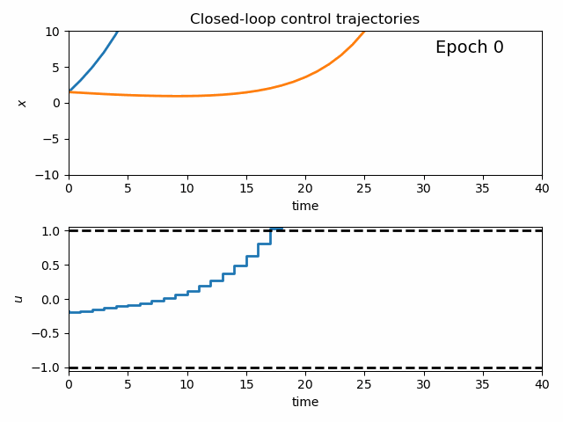
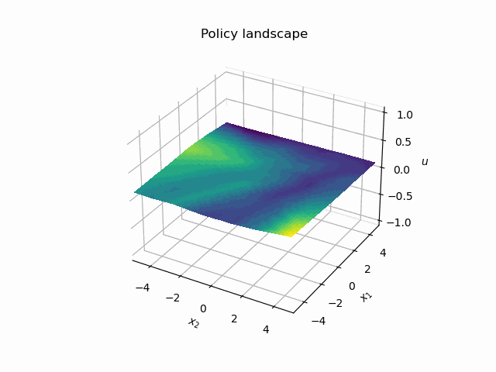
Dynamics of DPC Control Policy Learning
1341 learning parameters, 48.2 seconds offline training time on a CPU with 200 epochs.

Slide 14
Modeling Building Thermal Dynamics
Ján Drgona, et al., Physics-constrained deep learning of multi-zone building thermal dynamics, Energy and Buildings, 2021

Slide 15
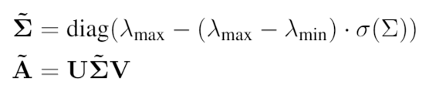
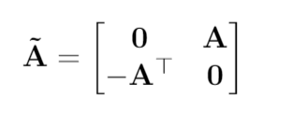
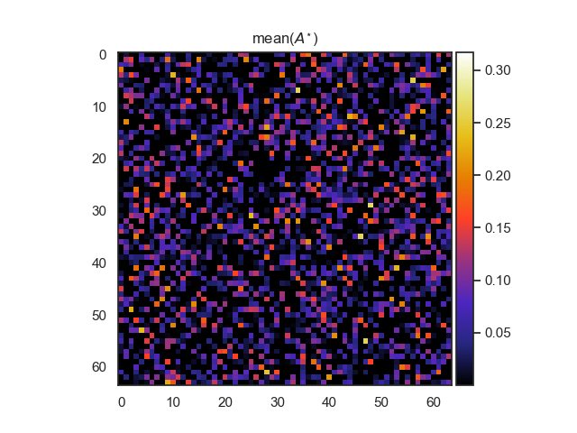
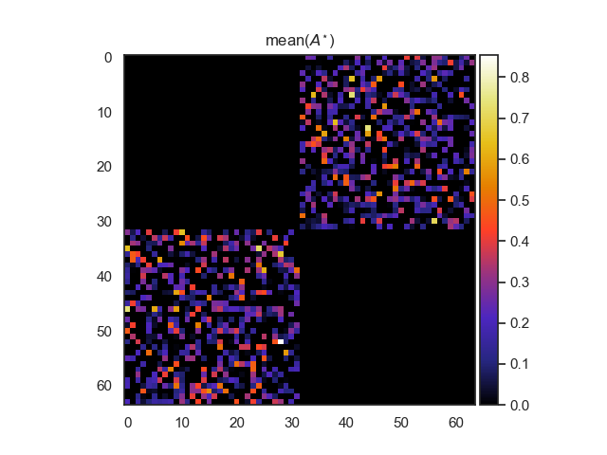
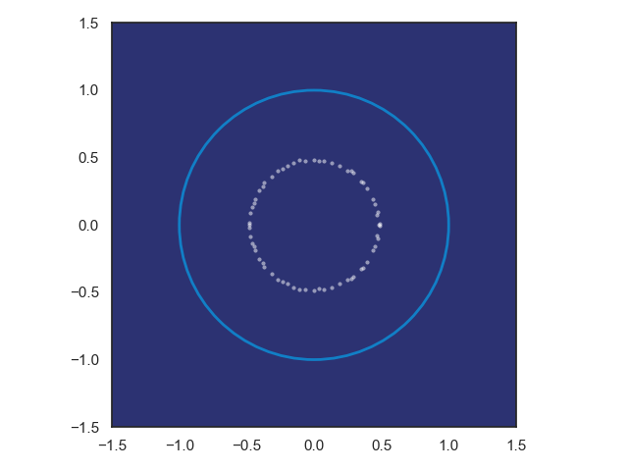
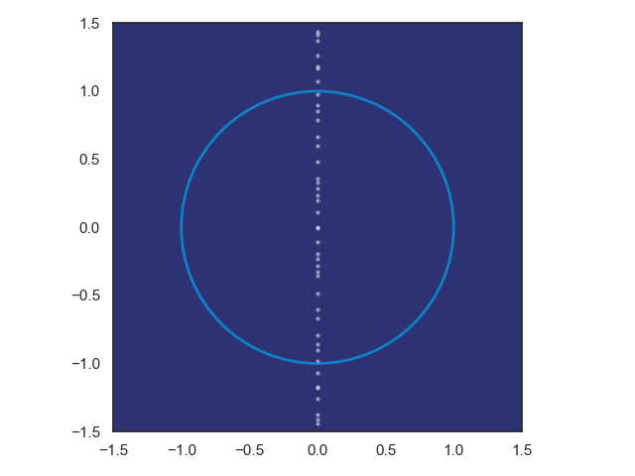
Structured Linear Maps with Eigenvalue Constraints
SVD factorization
Hamiltonian weight
Pytorch implementation: https://github.com/pnnl/slim
Jiong Zhang, et al., Stabilizing Gradients for Deep Neural Networks via Efficient SVD Parameterization, 2018. Eldad Haber and Lars Ruthotto, Stable Architectures for Deep Neural Networks 2017

Slide 16
Real World Data: Office Building

Slide 17
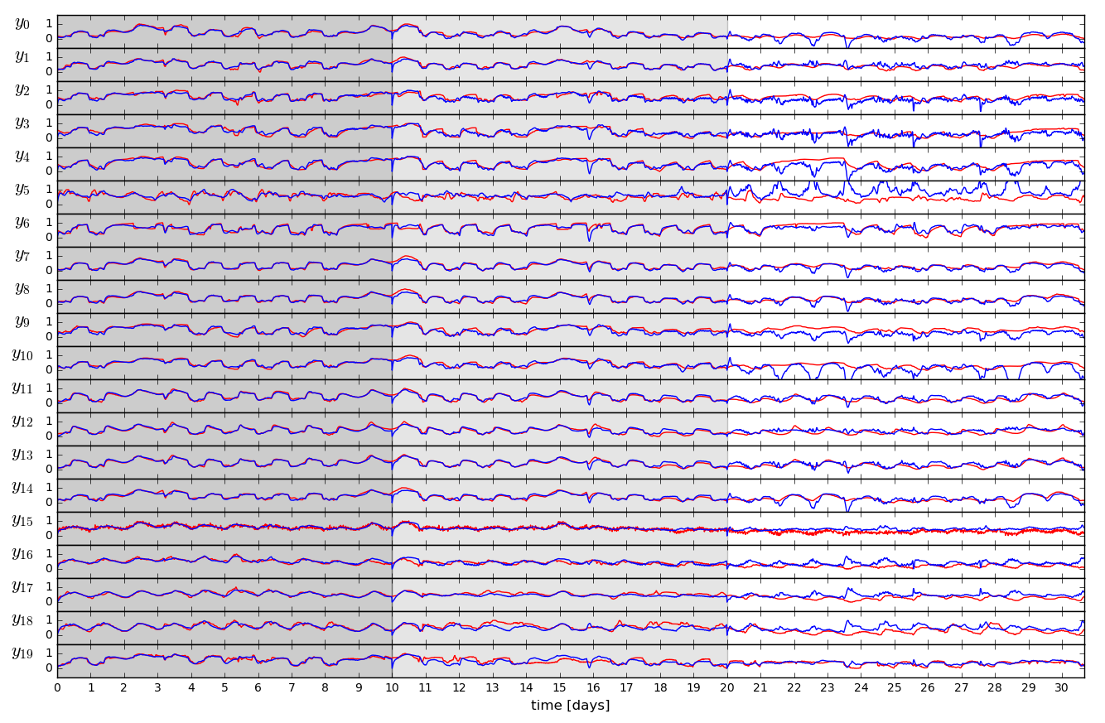
Open-loop Trajectories of Linear Dynamics Model
Ján Drgona, et. al, Physics-constrained deep learning of multi-zone building thermal dynamics, Energy and Buildings, 2021

Slide 18
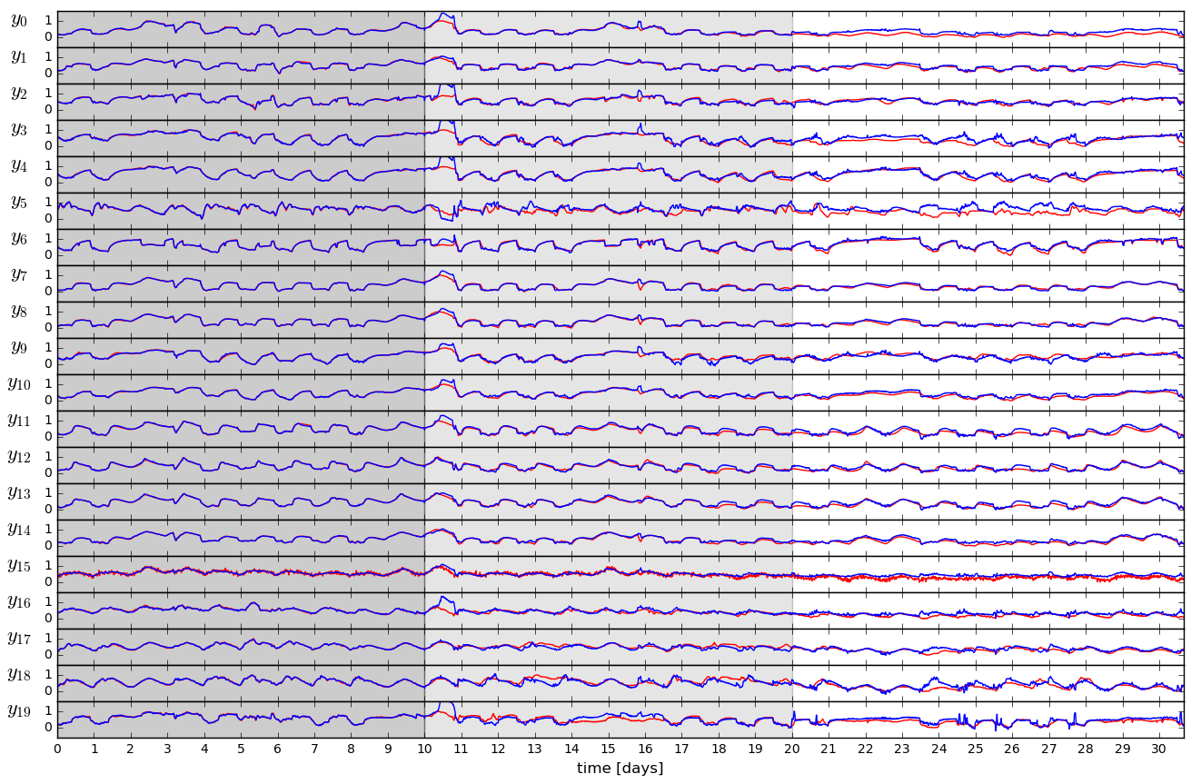
Open-loop Trajectories of Neural Dynamics Model
Ján Drgona, et. al, Physics-constrained deep learning of multi-zone building thermal dynamics, Energy and Buildings, 2021

Slide 19

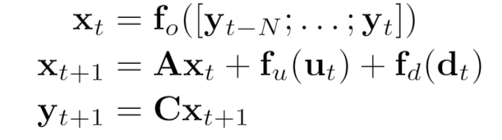
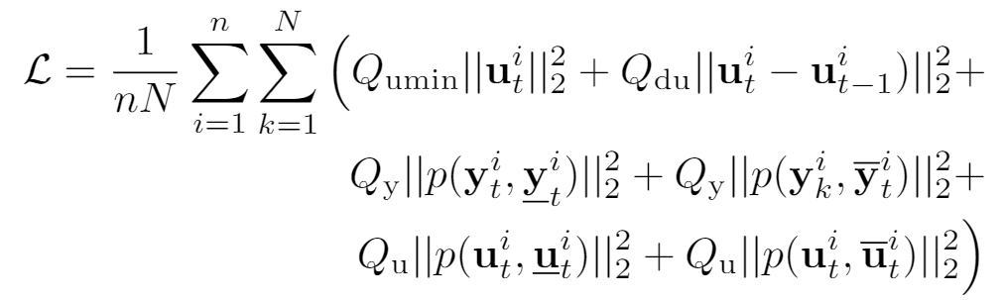
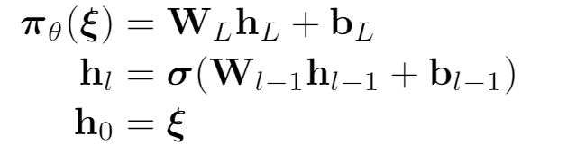
Economic DPC for Building Control
Economic MPC loss function
model
policy
Jan Drgona, Aaron Tuor, Elliott Skomski, Soumya Vasisht, Draguna Vrabie, Deep Learning Explicit Differentiable Predictive Control Laws for Buildings, IFAC NMPC 2021

Slide 20
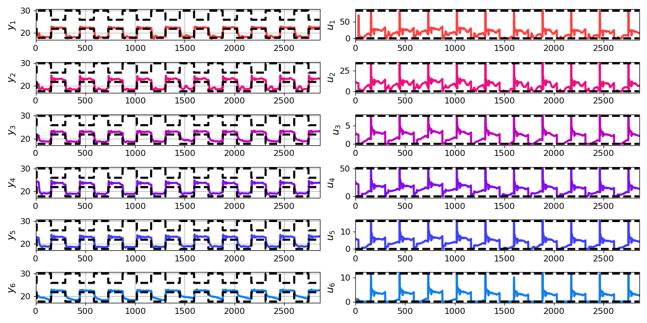
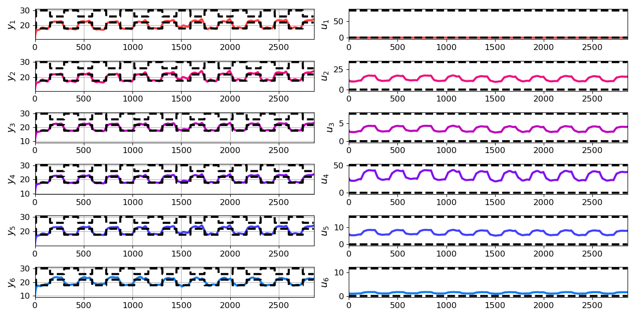
Closed-loop DPC of Multi-zone Building
Jan Drgona, Aaron Tuor, Elliott Skomski, Soumya Vasisht, Draguna Vrabie, Deep Learning Explicit Differentiable Predictive Control Laws for Buildings, IFAC NMPC 2021

Slide 21
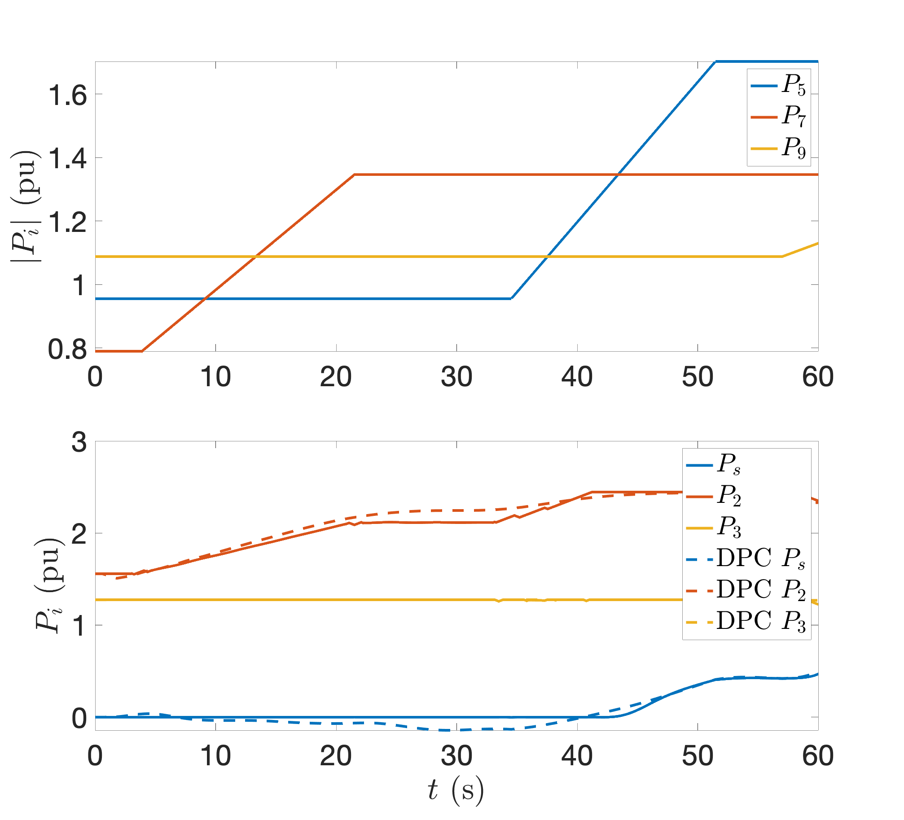
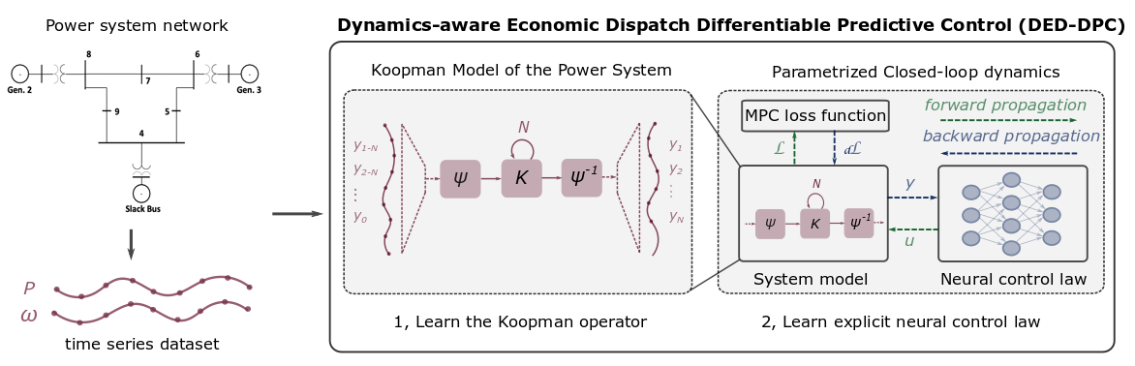
Dynamics-Aware Economic Dispatch via Differentiable Predictive Control
Domain Aware Koopman model incorporates known asymptotic behavior for high model fidelity on long timescales (6000 timesteps).
CNN control policy framework.
Results
5 orders of magnitude speed-up
Minimal loss in solution quality
Ethan King, Ján Drgoňa, Aaron Tuor, Shrirang Abhyankar, Craig Bakker, Arnab Bhattacharya, Draguna Vrabie, Koopman-based Differentiable Predictive Control for the Dynamics-Aware Economic Dispatch Problem, The 2022 American Control Conference (submitted)
Notes:
Add waveform figure as a result – copy from previous slide replace discretize linearize with one block as iterative method

Slide 22
Embedded Implementation of DPC for Edge AI
Flexy-Air system sketch with Raspberry-Pi controller
Jan Drgona, Karol Kis, Aaron Tuor, Draguna Vrabie, Martin Klauco, Differentiable Predictive Control: An MPC Alternative for Unknown Nonlinear Systems using Constrained Deep Learning; arXiv:2011.03699

Slide 23
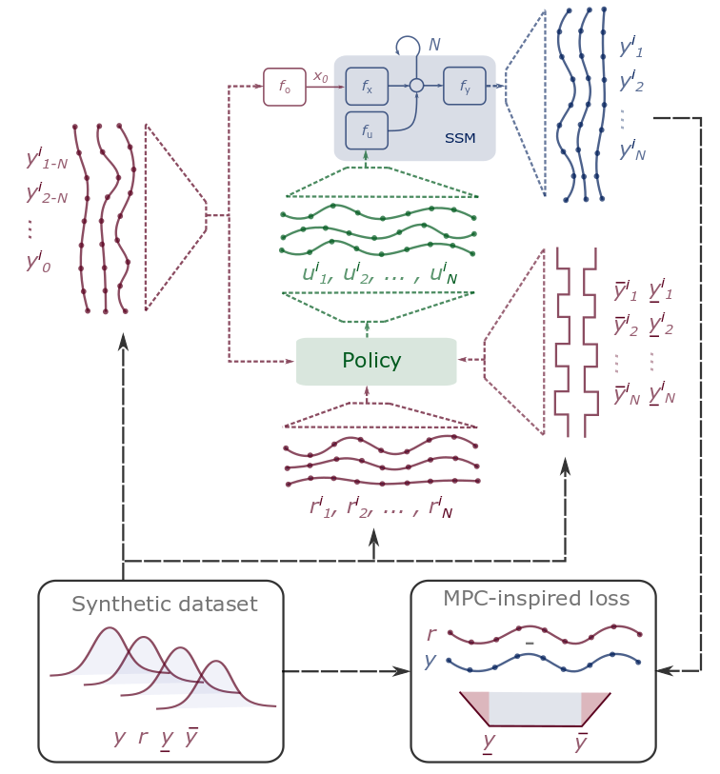
Conclusion
Differentiable Predictive Control
Differentiable closed-loop system model
Explicit control policies
State and input constraints
Embedded implementation
Theoretical connection with MPC
Open-source Code
Neuromancer software package
https://github.com/pnnl/neuromancer
Structured linear maps in Pytorch
https://pnnl.github.io/slim/
Jan Drgona, et al., Differentiable Predictive Control: An MPC Alternative for Unknown Nonlinear Systems using Constrained Deep Learning https://arxiv.org/abs/2011.03699
Jan Drgona, Aaron Tuor, Draguna Vrabie, Constrained Physics-Informed Deep Learning for Stable System Identification and Control of Unknown Linear Systems https://arxiv.org/abs/2004.11184

